Slide 1

Medication Management Database
Presentation by:
Gabriel Penzo

Slide 2
Table of contents
Introduction
Medication Management System
E-R Diagram
Objectives
Methodology
Results
Conclusion

Slide 3

Introduction
The presentation aims to share the many functionalities of a medication management system. Healthcare data grows exponentially day by day and it is critical to manage the data efficiently. Databases must show accuracy and maintain privacy while allowing healthcare providers to access patient records swiftly. The project focuses on the creation of a robust database that connects patients and prescriptions while providing details of the patient’s insurance, medication information, and pharmacies.

Slide 4
Medication Management System
The Medication Management System is an electronic repository for patient-level prescription medication data that enables real-time access for healthcare providers. It is designed to link prescription medication data across patients, providers, insurance companies, and pharmacies.
Proper medication management can lead to better treatment outcomes, reduced healthcare costs, and enhanced data collection. By creating a network between different providers, the database can be used by physicians, pharmacists, and insurance representatives to ensure an optimal treatment pathway for the patient.
The database contains 6 tables: Patient, Prescription, Medication, Doctor, Pharmacy, and Insurance. The patient table is the master table since this database is patient-centered. Each table design will be shown in the next slide.

Slide 5
Patient (Master Table)
Prescription (Child Table)
Attributes | Data Type
Patient_ID | Varchar (primary key)
Name | Varchar
Gender | Varchar
Age | Int
Address | Varchar
City | Varchar
Attributes | Data Type
Prescription_ID | Varchar (primary key)
Prescription_Name | Varchar
Dosage_Instructions | Varchar
Duration | Varchar
Date_Issued | Date
Patient_ID | Varchar(references Patient)
1: M
1: M
M:1
Insurance (Child Table)
Medication (Child Table)
Attributes | Data Type
Insurance_ID | Varchar (primary key)
Coverage_Info | Varchar
Provider | Varchar
Policy_Number | Varchar
Patient_ID | Varchar(references Patient)
Attributes | Data Type
Medication_ID | Varchar (primary key)
Name | Varchar
Dosage | Varchar
Form | Varchar

Slide 6
Pharmacy (Child Table)
From Prescription
M:1
Attributes | Data Type
Pharmacy_ID | Varchar (primary key)
Name | Varchar
Address | Varchar
Contact_Information | Varchar
Prescription_ID | Varchar(references Prescription)
From Prescription
M:1
Doctor (Child Table)
Attributes | Data Type
Doctor_ID | Varchar (primary key)
Name | Varchar
Specialization | Varchar
Contact_Info | Varchar

Slide 7
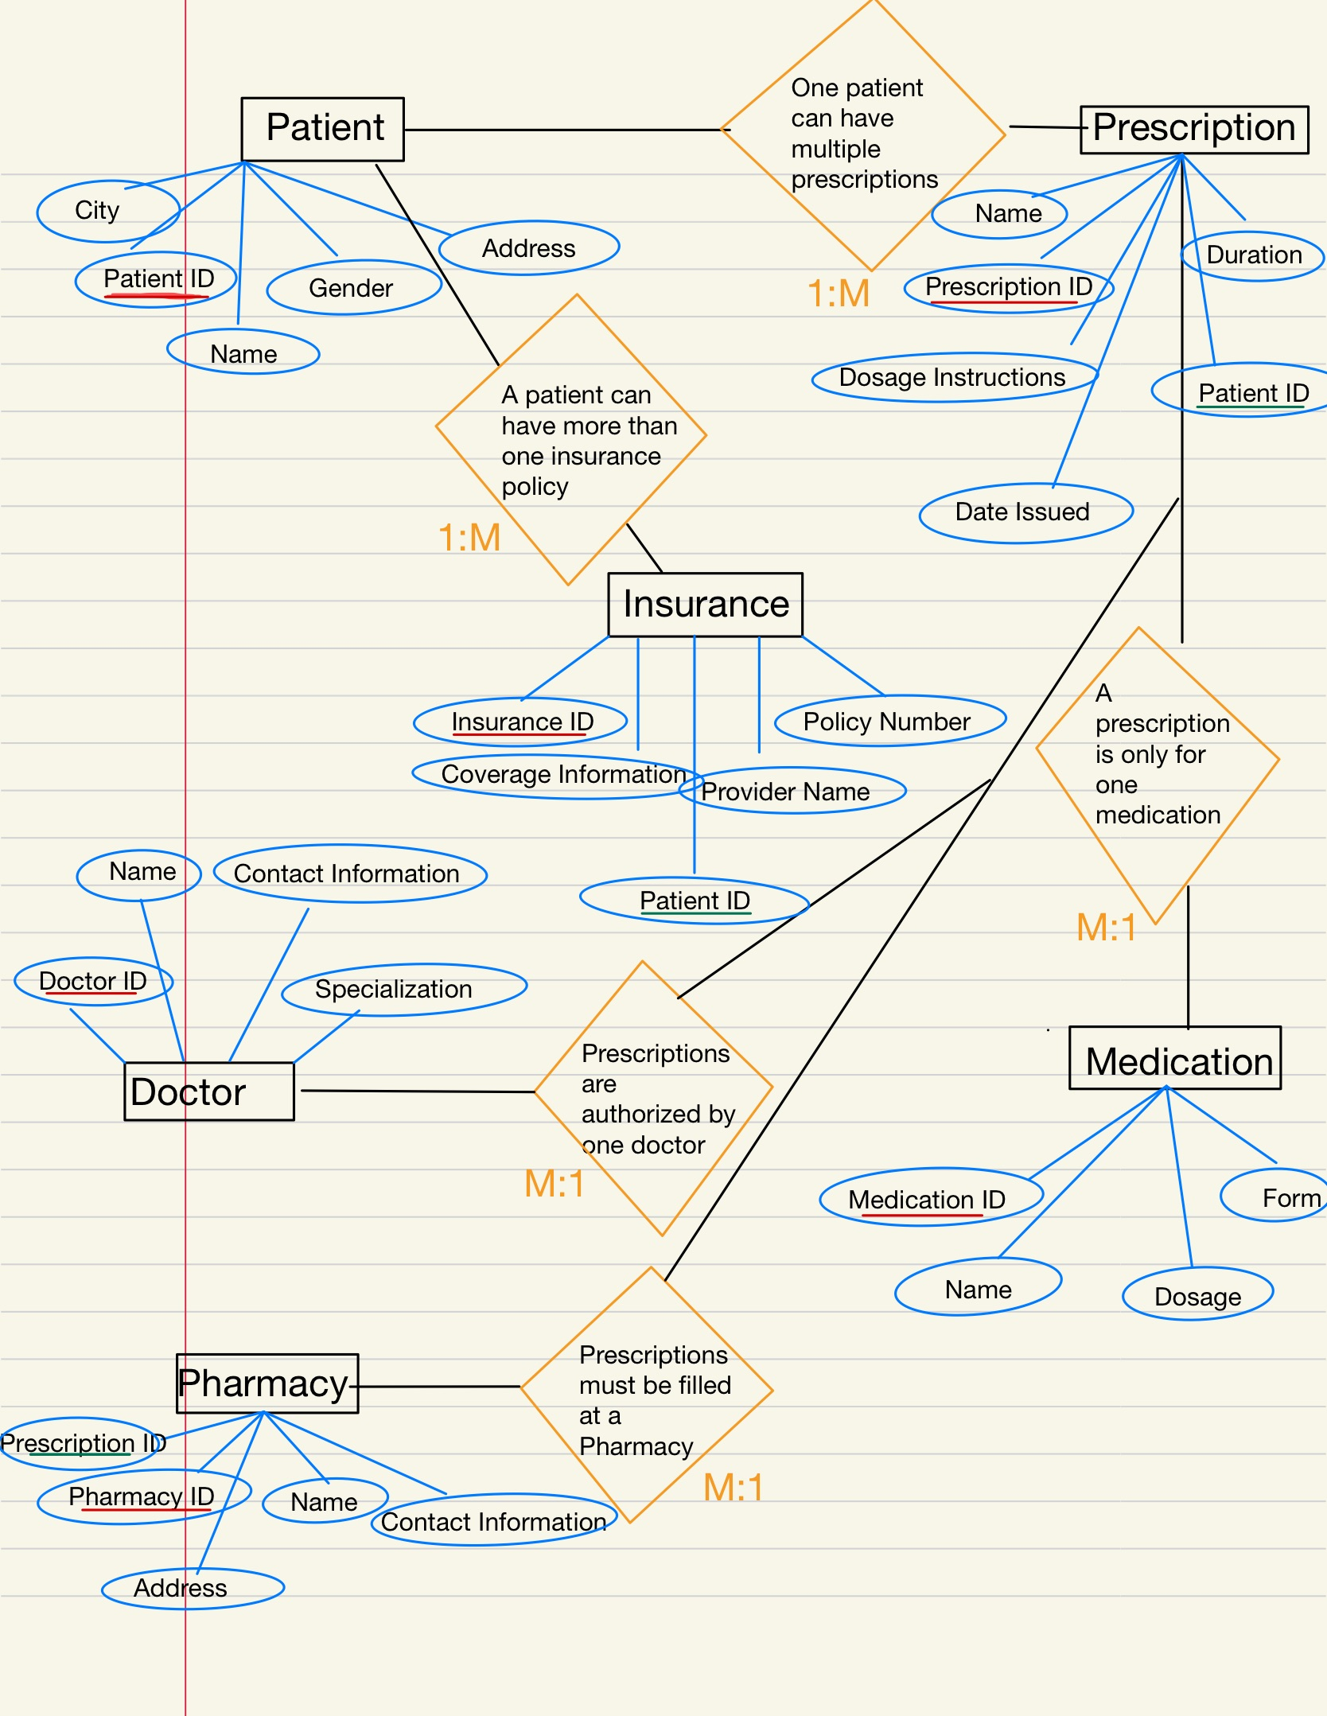
E-R Diagram
The E-R diagram shows each table, its attributes, and its relationship type.

Slide 8
Objectives
1. Add a new patient record, update a patient’s address, remove a patient record from the master table, and roll back to a savepoint.
2. Find all prescriptions issued to a patient.
3. Update the dosage information for a medication.
4. Find the contact information for the pharmacy where a prescription was filled.
5. Generate a report on patient age distribution.
6. List all patients with their latest prescription and insurance provider.
7. Find the total number of prescriptions for each medication and the pharmacy where it was filled.
8. List all patients with Full Coverage.
9. Find the names of all patients who have had a prescription for ‘Lorazepam’.
10. Categorize patients based on their age groups.
11. Create an index to improve search on doctor’s specialization.
12. Which doctors’ last names start with M?
13. Create a view that will help insurance representatives to access information.
14. Which medications have been prescribed more than once?

Slide 9
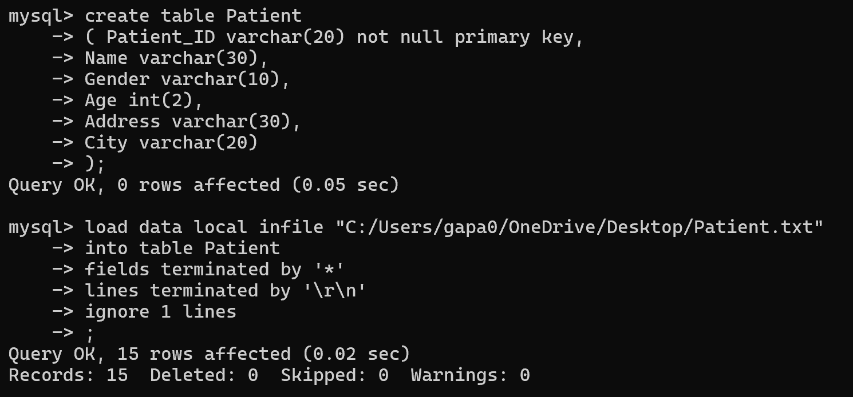
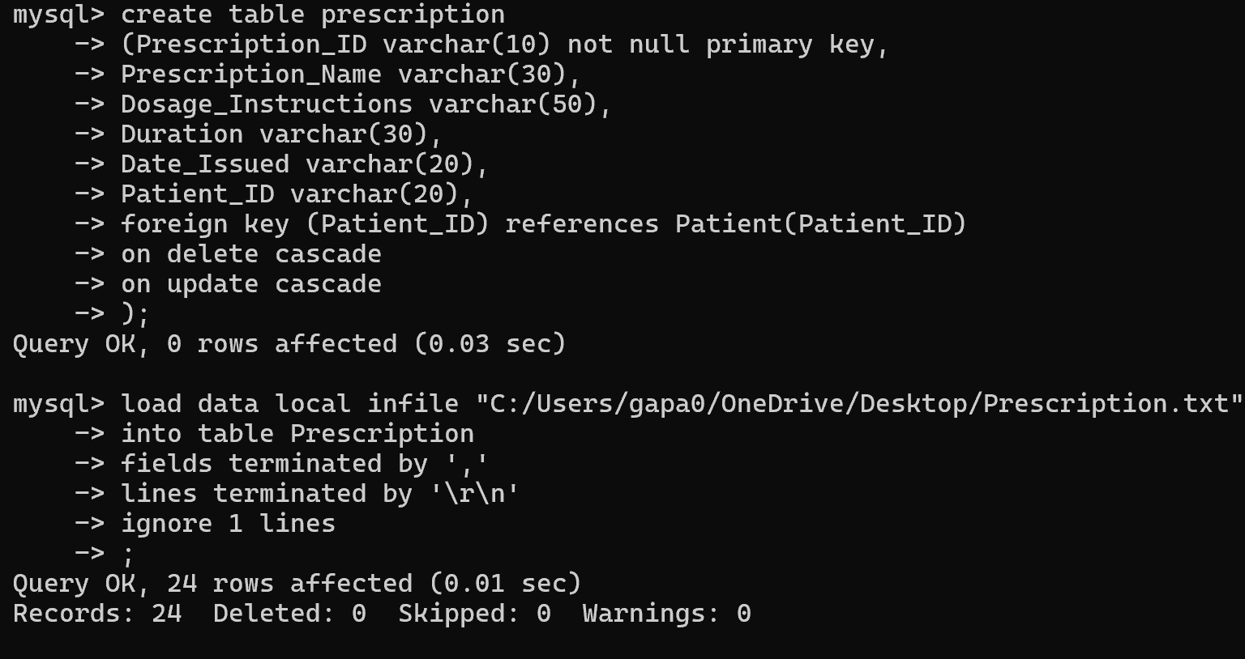
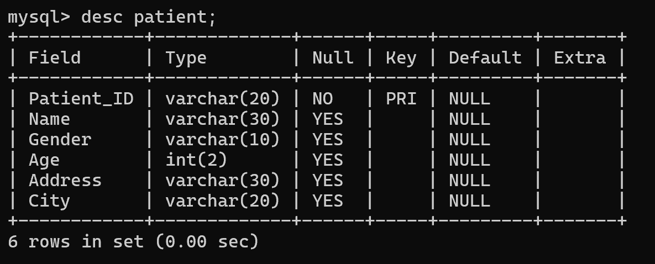
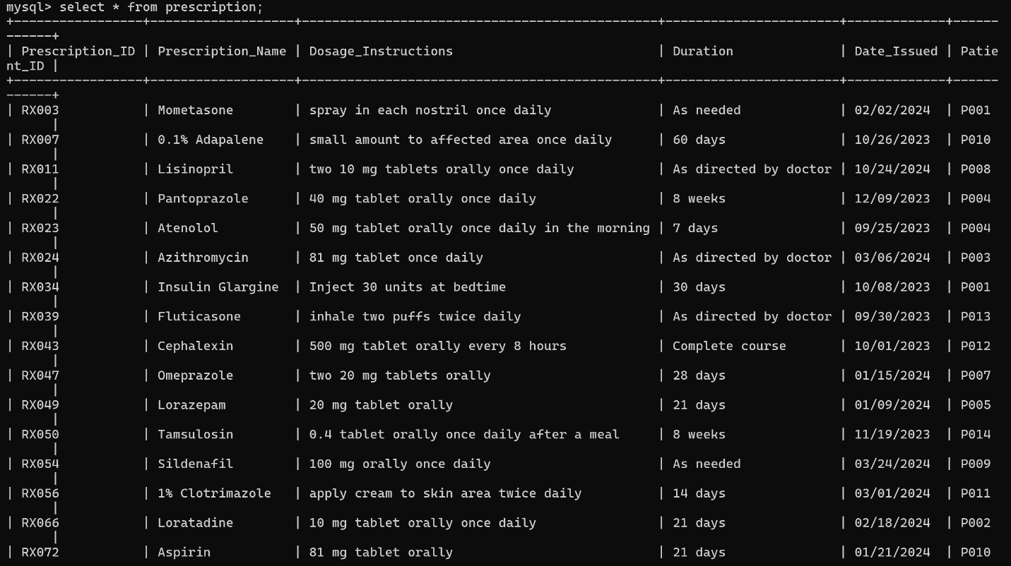
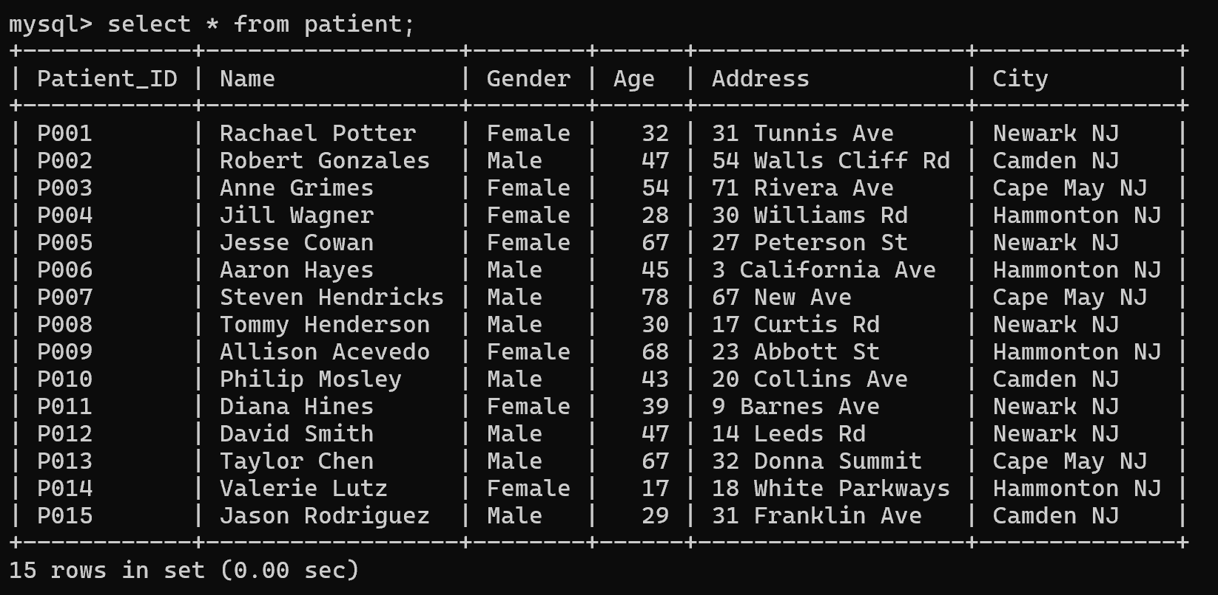
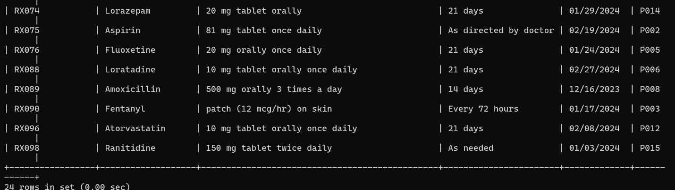
Methodology
Patient
Prescription
By using MySQL environment, six tables were created and saved in the database “final_project”.

Slide 10
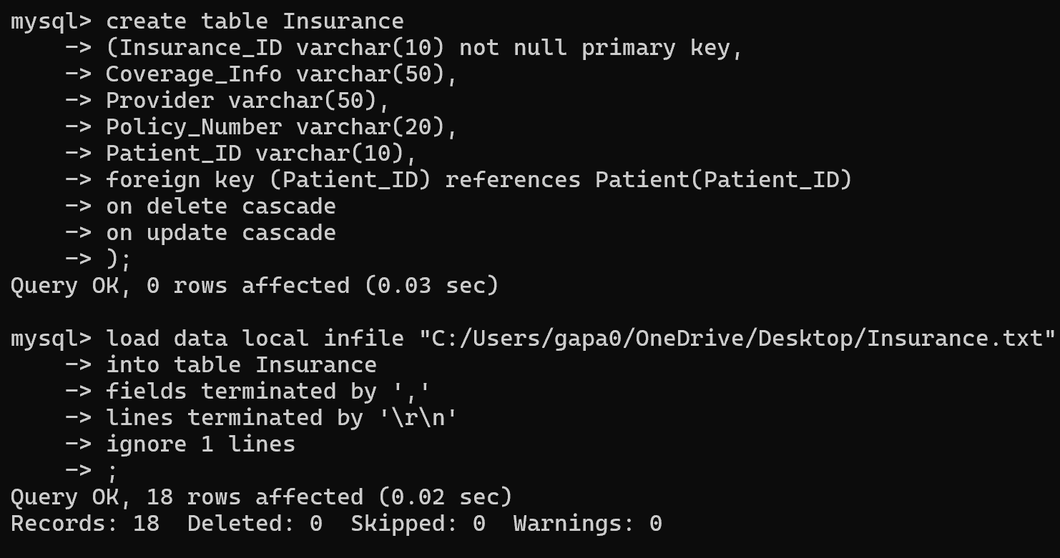
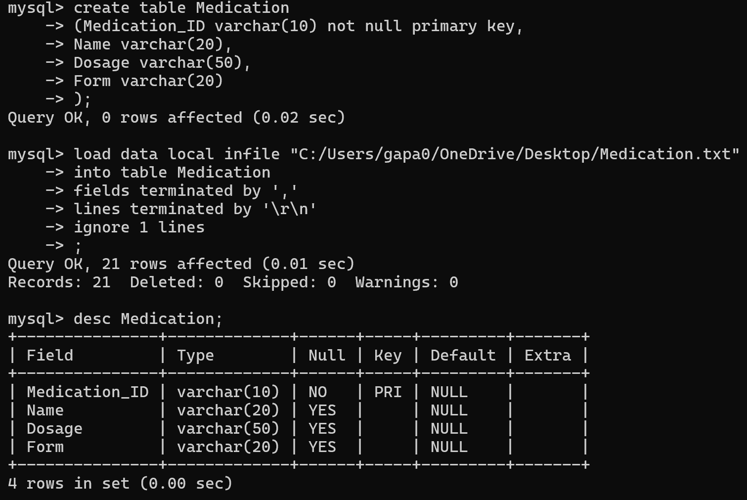
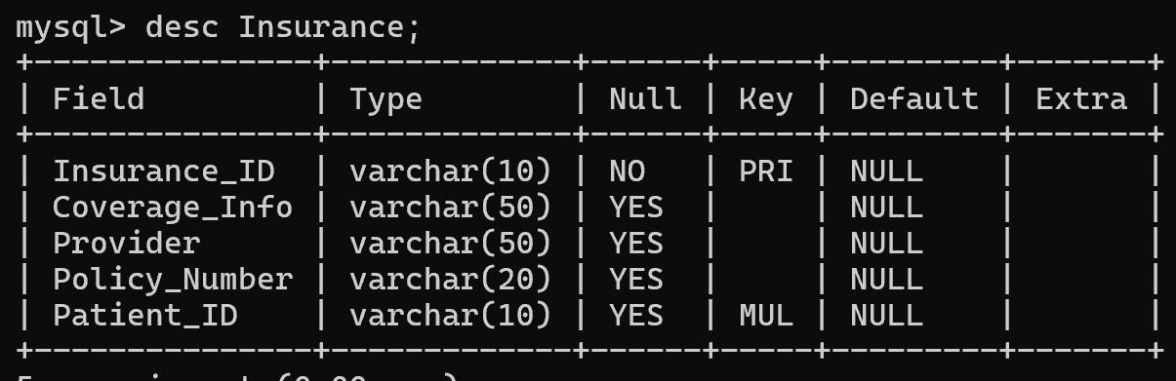
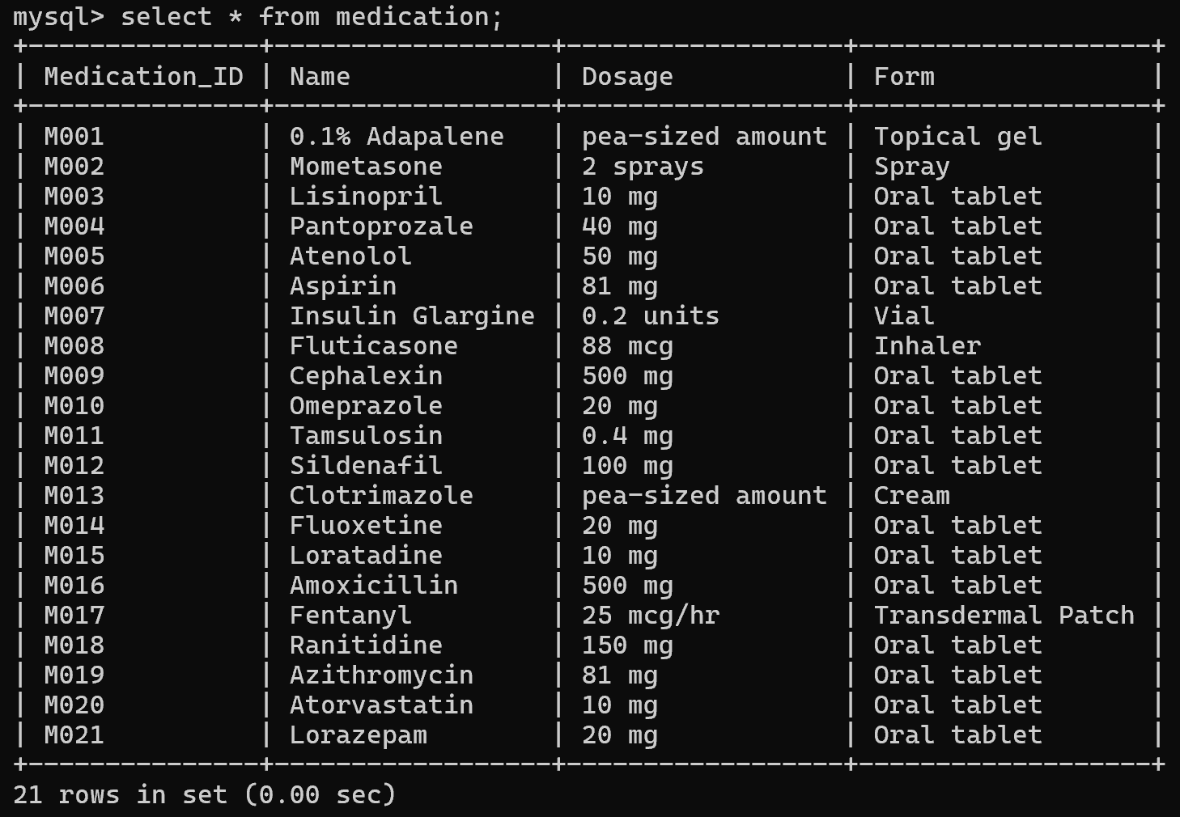
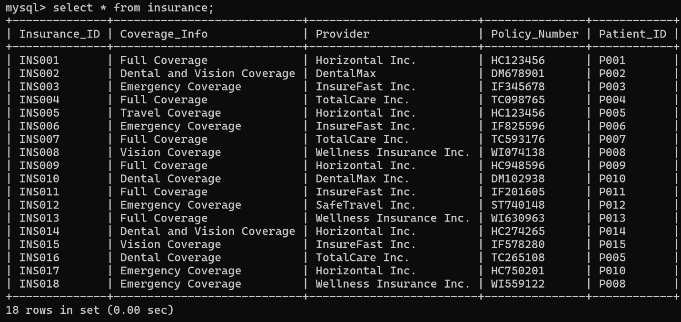
Insurance
Medication

Slide 11
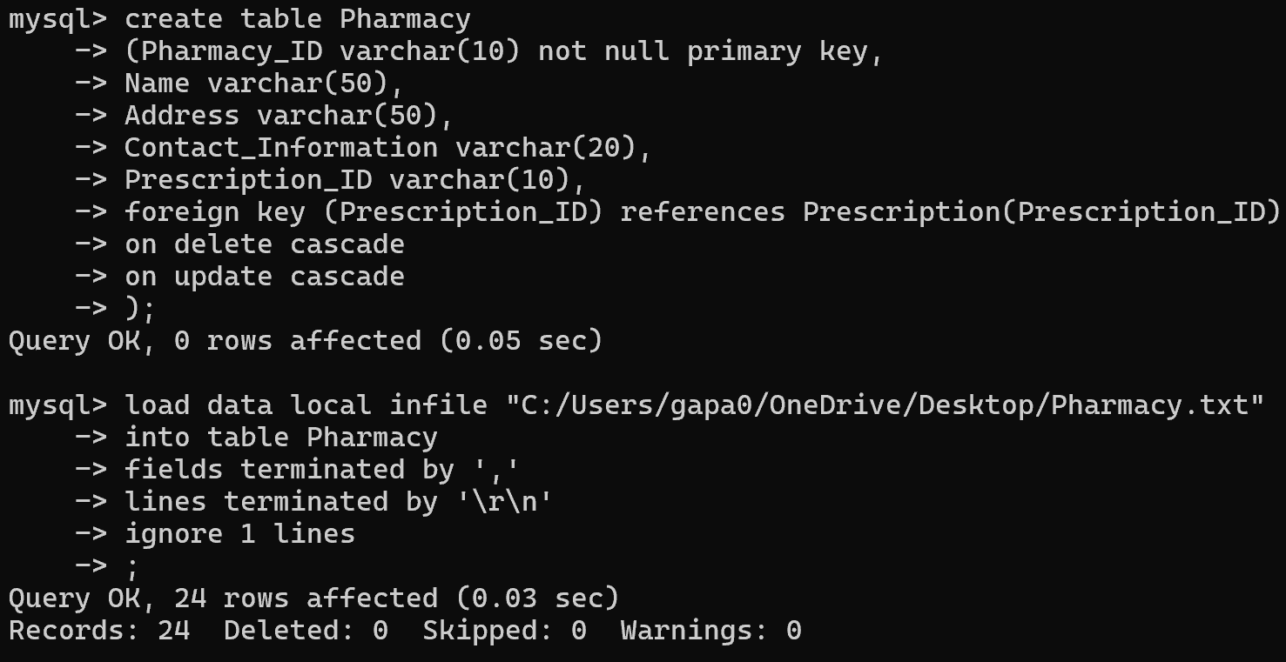
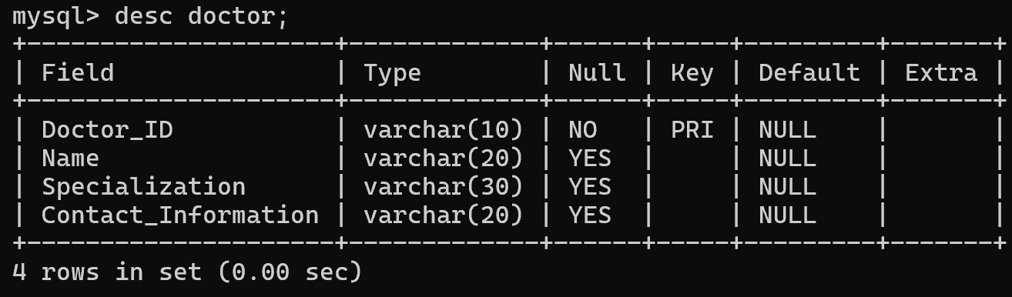
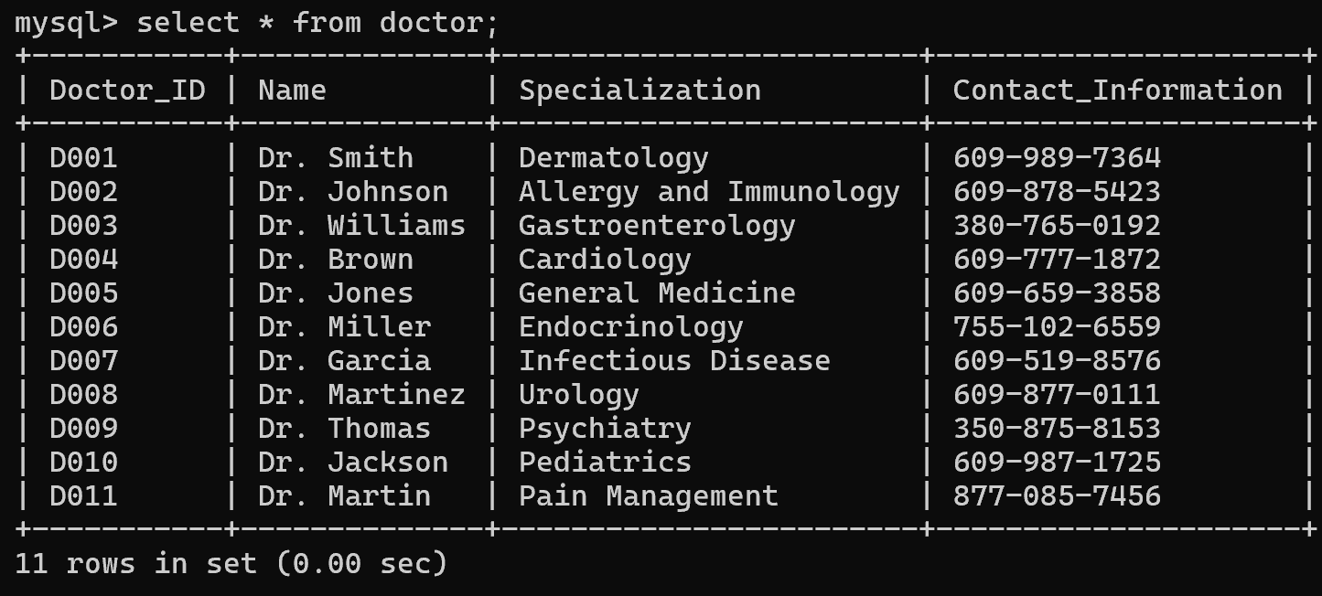
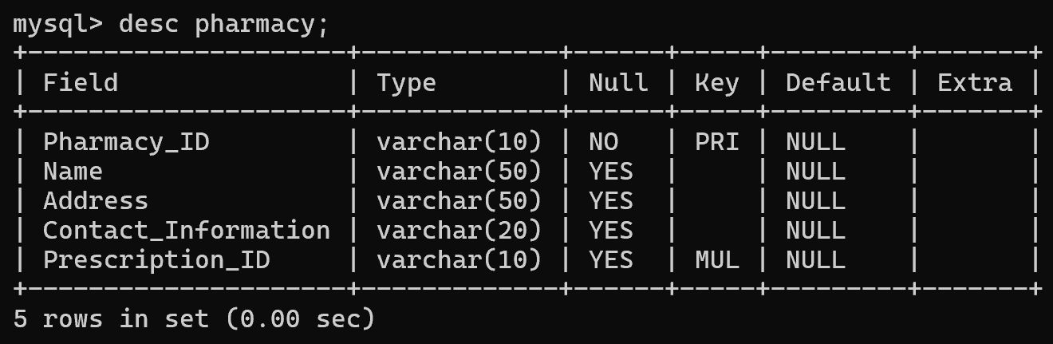
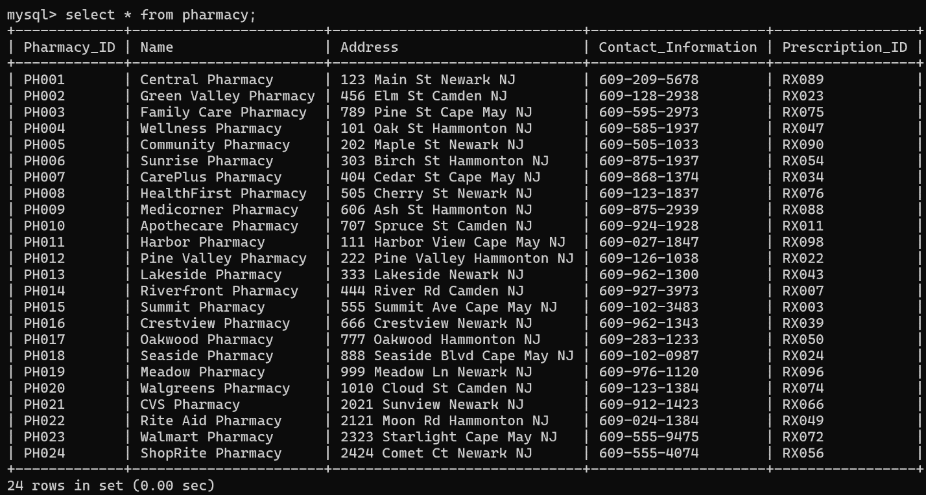
Pharmacy
Doctor

Slide 12
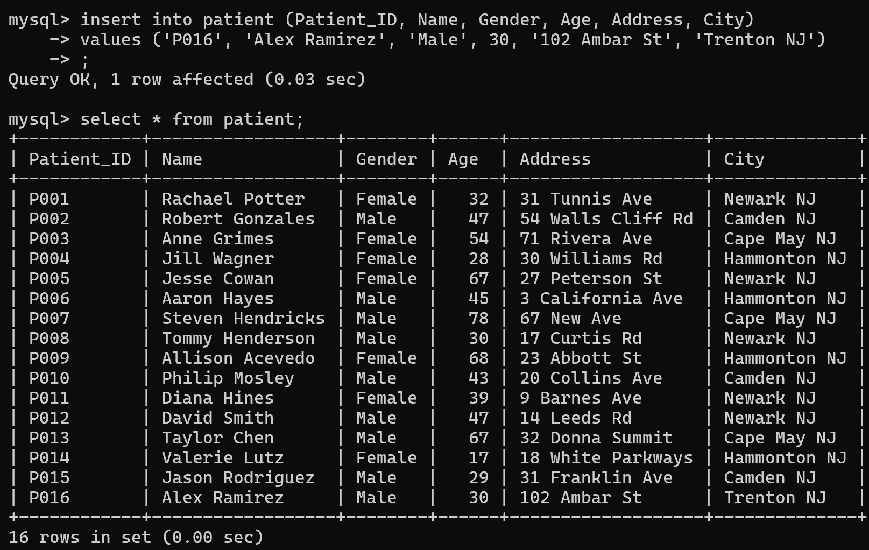
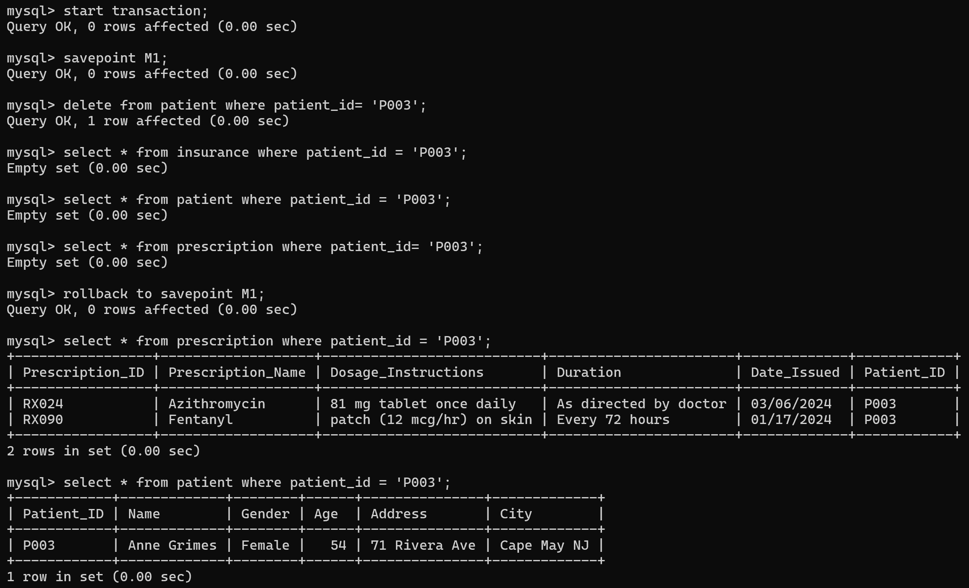
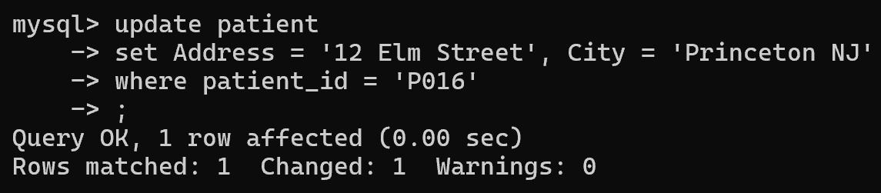
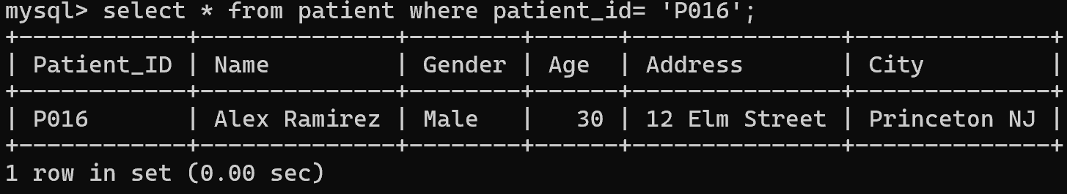
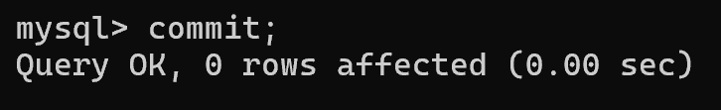
Results
Remove a different patient from the master table. This query shows how after removing P003 from the master table, it was also removed from the other tables. After the rollback, the patient is back in the tables.
Objective 1
Insert new patient
Update the patient’s address

Slide 13
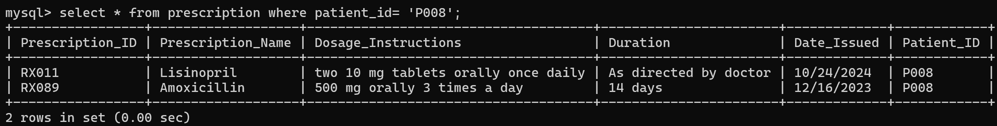
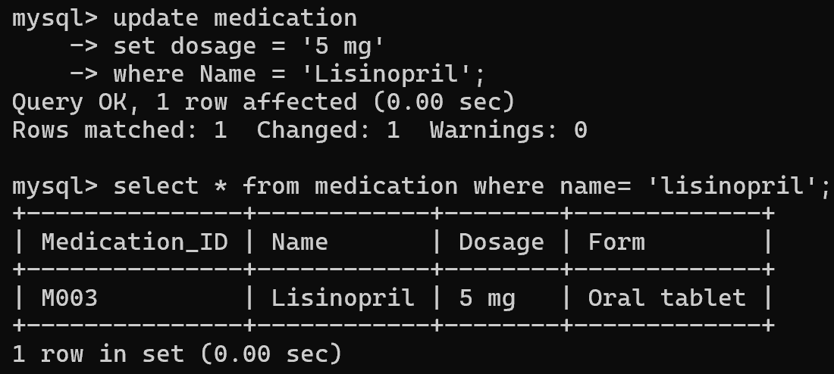
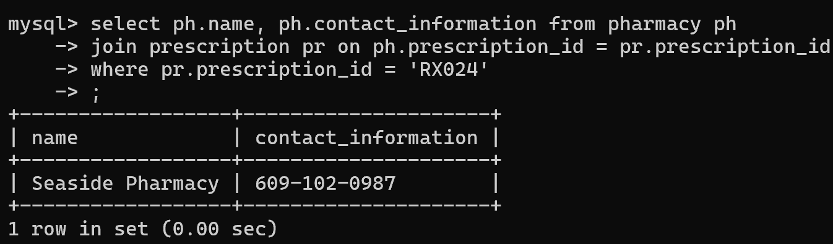
Objective 2
Find prescriptions issued to a patient.
Objective 3
Objective 4
Find the contact information for the pharmacy where a prescription was filled. This query uses joins.
Update dosage for a medication.

Slide 14
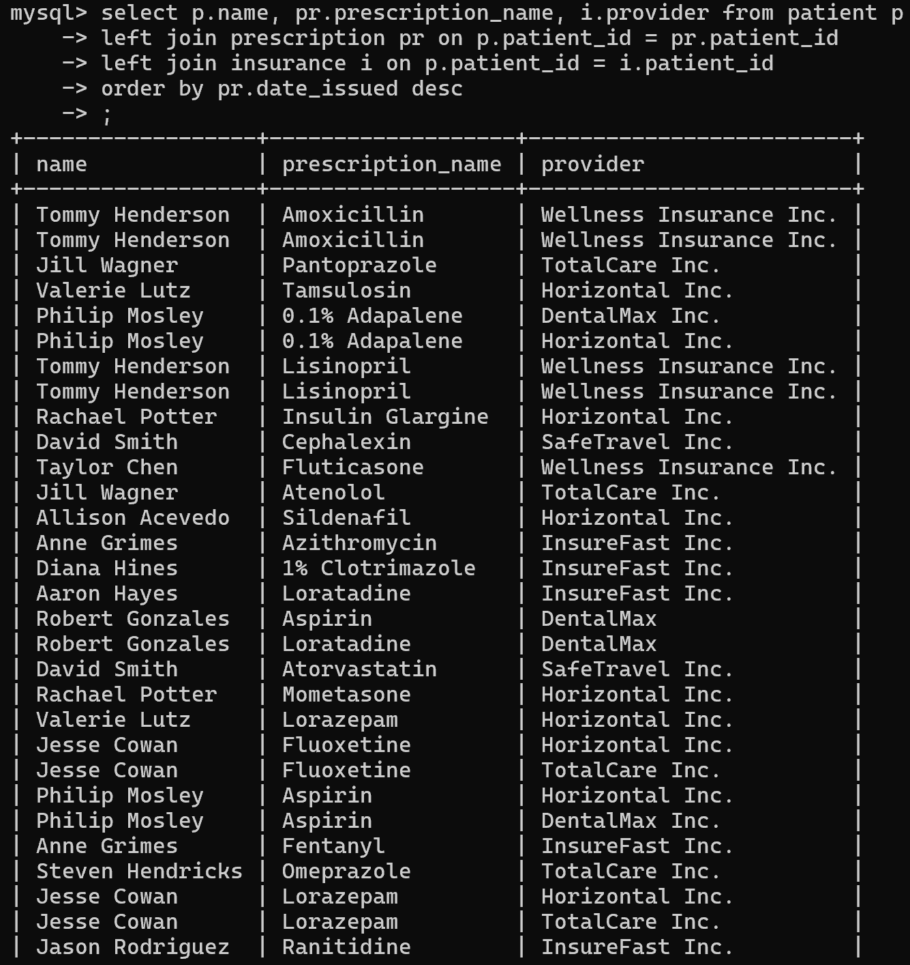
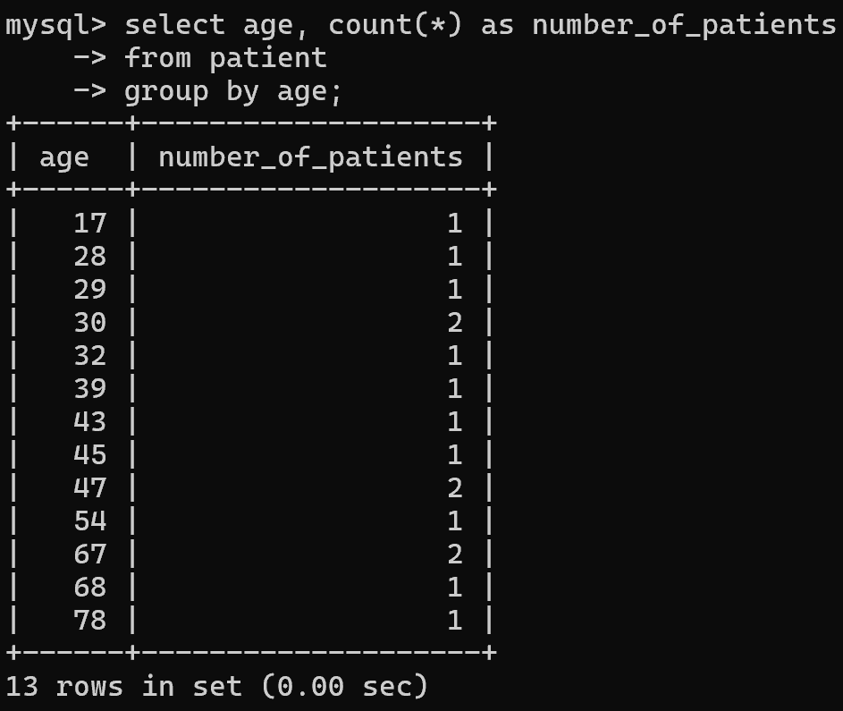
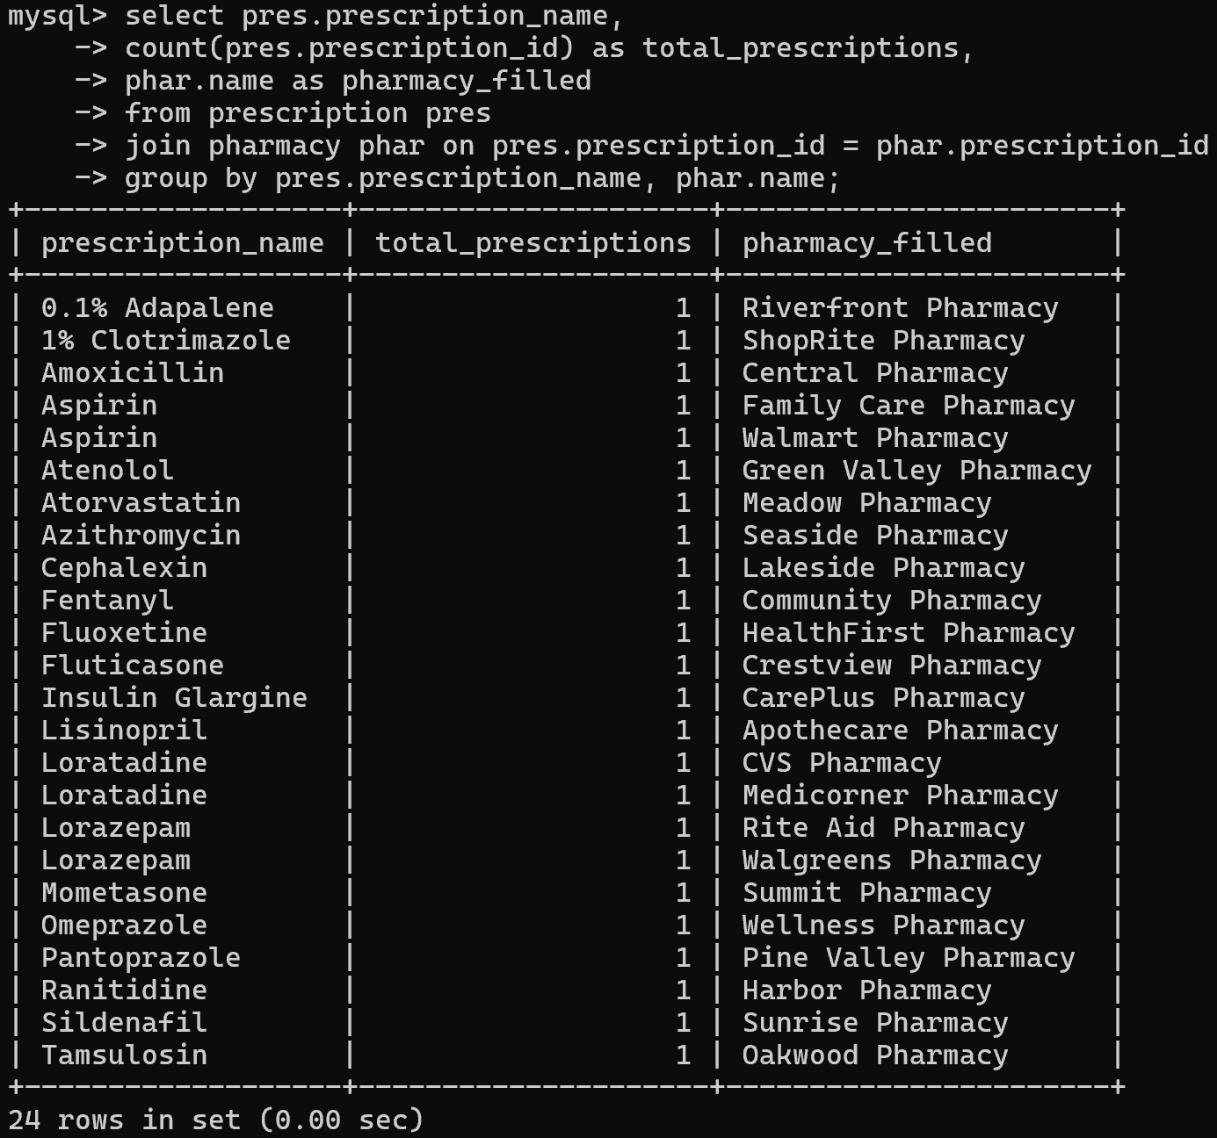
Objective 5
Objective 6
Objective 7
Generate a report on patient age distribution. Using the count() function.
List all patients with their latest prescription and insurance provider. Uses left joins and order by function.
Total number of prescriptions for each medication and the pharmacy where it was filled. Uses group by function.

Slide 15
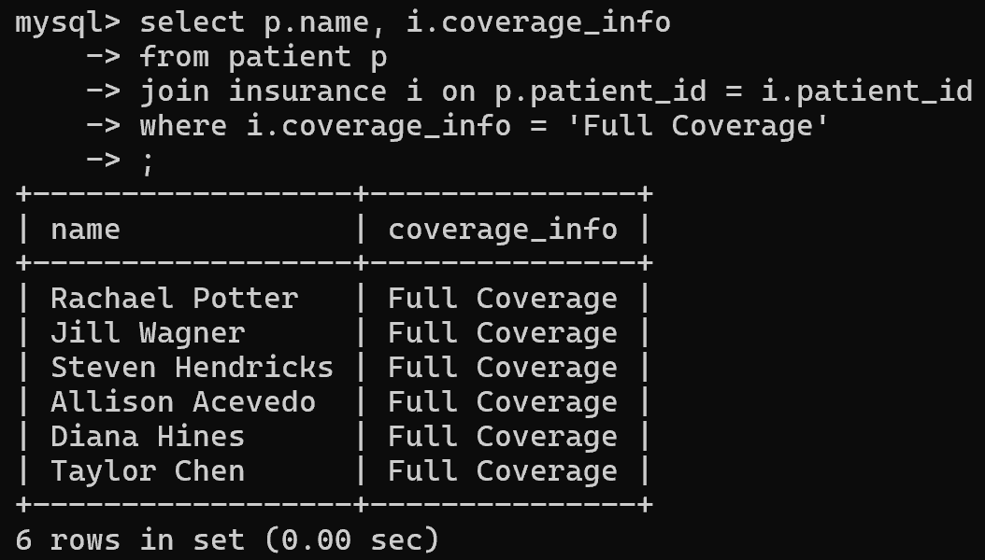
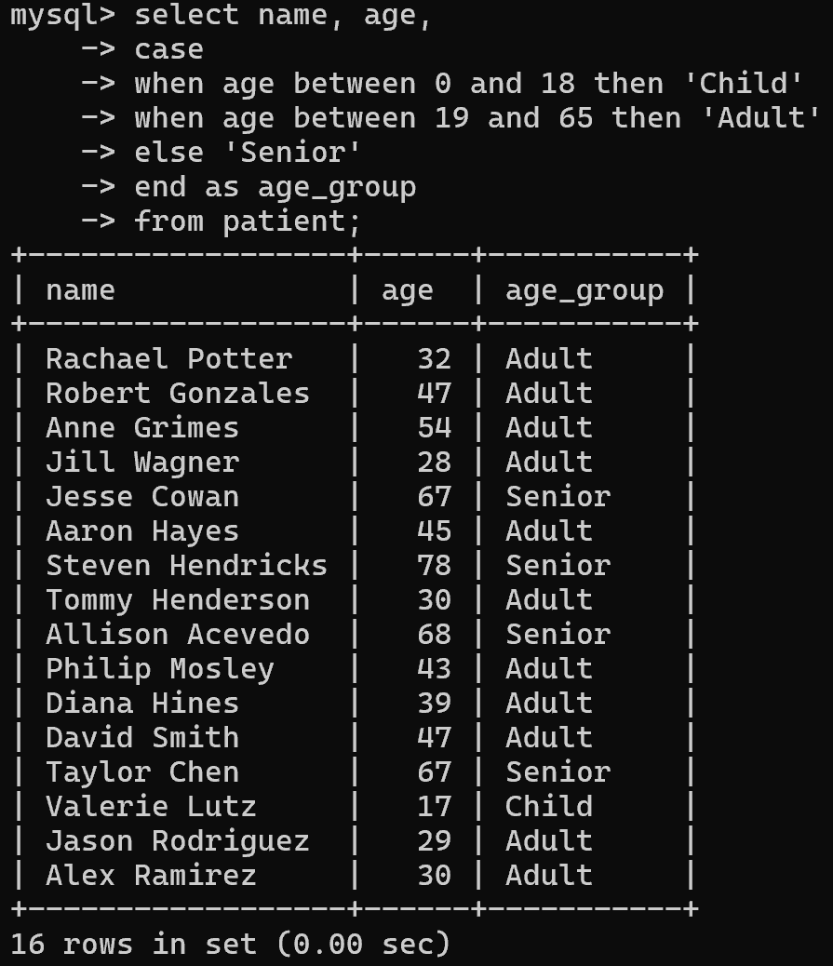
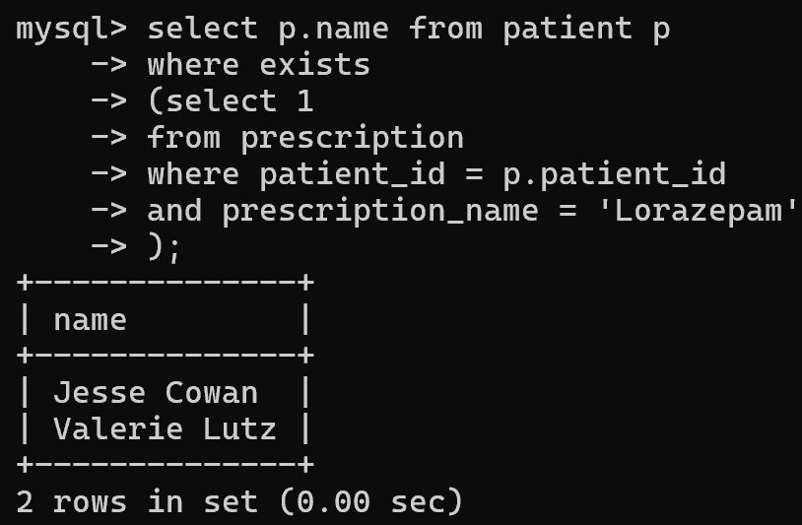
Objective 8
Objective 10
List all patients with Full Coverage.
Categorization of patients based on their age groups. Uses Case statement.
Objective 9
List of patients who are prescribed with Lorazepam. Using inner query.

Slide 16
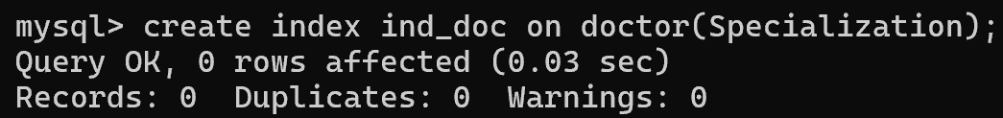
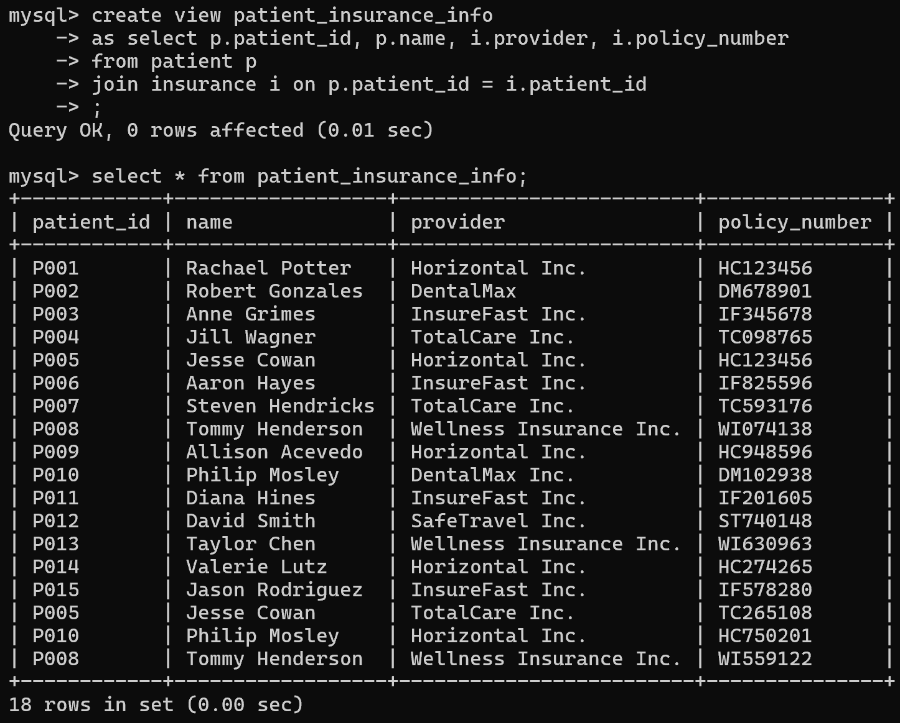
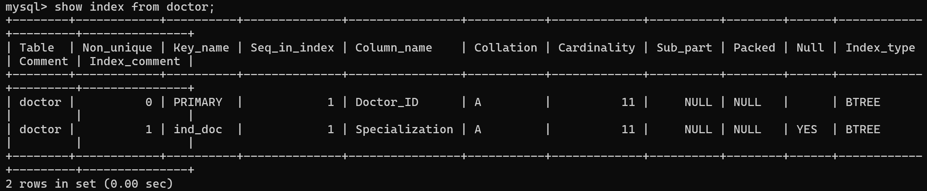
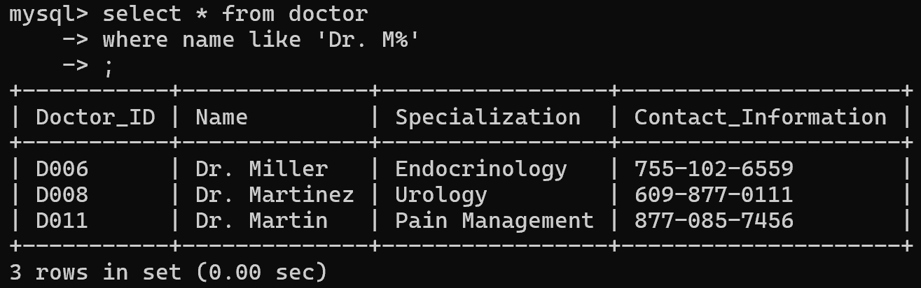
Objective 11
Objective 13
Create an index to improve search on doctor’s specialization.
Create a view that will help insurance representatives to access information.
Objective 12
Which doctors’ last names start with M? Using the like function.

Slide 17
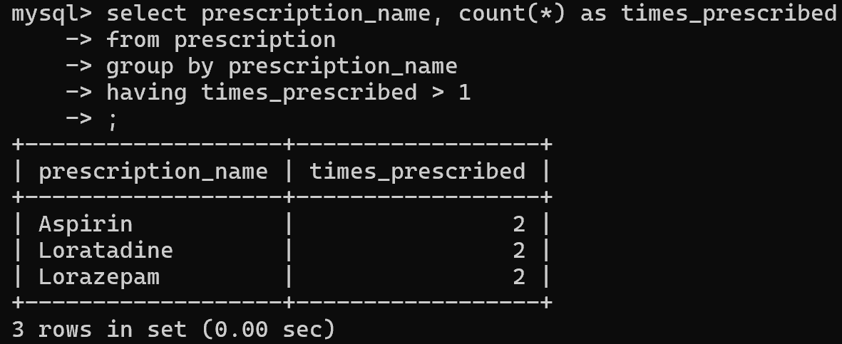
Objective 14
Which medications have been prescribed more than once? Using the having clause.

Slide 18
Conclusion
With the creation of this database, many functionalities of the MySQL environment were explored using the Medication Management System.
By having multiple relationships, it is easier for healthcare providers to link different attributes and get the required patient information.
The integration of such databases is important in an era that relies on adaptability, performance, and efficacy when handling data.

